Slide 1

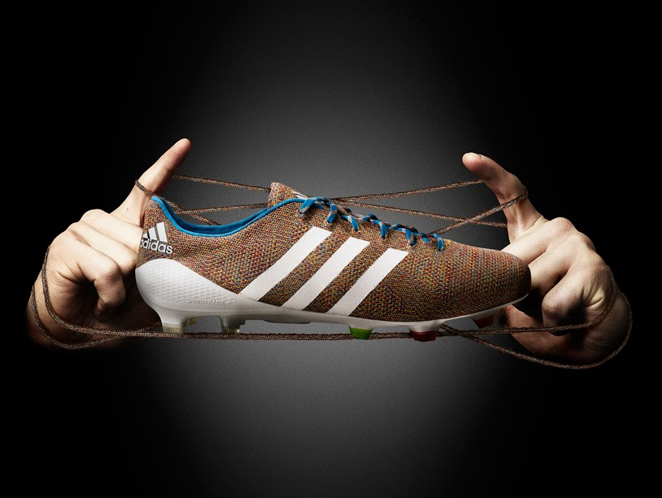

Adidas vs nike competitive Analysis

Slide 2

Adidas History
Adidas is an exceptionally large footwear company, but not as big as Nike.
Adidas is larger than other global footwear companies.
Adidas is the second largest footwear industry in the world.
Adidas revenue was $25 billion in 2021.
Adidas shoes are traditionally less expensive than Nike.

Slide 3

Nike's History
Nike is the largest footwear company in the world and their revenue was $44.53 billion in 2021.
Nike released their latest projects because of their large revenue and endless profits.
Nike’s revenue allowed them to create an athlete’s lab to assist athletes in obtaining enhance performance.
Nike has power over 25% of the global athletic footwear market.

Slide 4
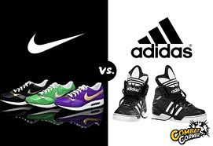
Adidas Vs. Nike Dataset
10 Attributes:
Product Name
Product ID
Product Listing
Listing Price
Sale Price
Discount
Brand
Description
Rating
Reviews
Last_Visited

Slide 5
Results
Adidas Originals brand within the brand and sale price cluster, appeared to have the highest sale price of $30,000 versus the other Adidas brands and Nike.
The brand with the lowest sale’s price of $8,000 was Adidas Core/NEO.
Nike’s brand had the second lowest sale price at approximately $25,000, and the Adidas Sport Performance brand sales’ price was approximately $20,000.
The rating and brand cluster has higher consumer ratings than Nike’s brand. Nike’s brand consumer ratings are close to the number of Adidas brands’ consumer ratings.

Slide 6
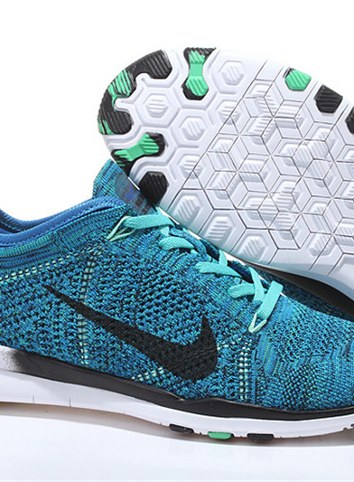
Conclusion
I thought the Nike brand was more of a competitive brand versus the Adidas brands because of Nike’s footwear quality and popularity.
The Adidas brands had higher ratings and sale prices versus the Nike brand.
The brands’ sale price data is very vital within the clusters and graphs.
The ratings exceedingly important attributes that were dispersed among the products and brands within the clusters.
Based on the results, the sale prices are ideas that consumers mostly think of while searching throughout the footwear brands.
The consumers’ ratings of the brand products depend on their personal inclinations.

Slide 7

ANy Questions?

